Slide 1
UCAS Application
Right First Time

Slide 2
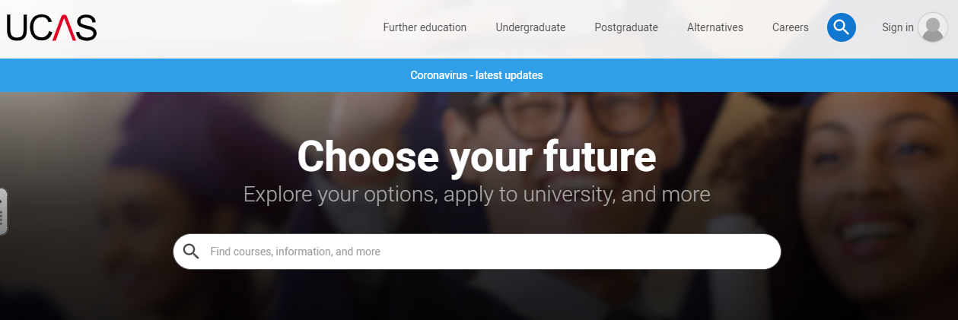
Register with UCAS 2021
To begin the application process for university, you will need to register an account and link this to our college.
The registration process is free and can be started today if you wish. ALL Y13 students will be asked to register for 2021

Slide 3
Register with UCAS 2021
UCAS: - This is the centralised organisation that handles all applications for entry into higher education.
They act as a clearing house, processing all submissions from students and staff, forwarding applications to institutions and then dealing with the offers, acceptances and clearing processes that follow.
You must go through UCAS to make any higher education application.

Slide 4
How to REGISTER with UCAS
1. Go to ucas.com
2. Click on icon Select Sign in > Students
3. Select Undergraduate
!! 4. IMPORTANT - Select 2021 entry !!

Slide 5
Proceed to REGISTER
Read and agree to the UCAS terms and conditions
Initial details – Select Title and Gender
Enter First name (only) and Surname
Ensure that you correctly capitalise your name : e.g Luke Skywalker
Enter your date of birth
Enter postal address details

Slide 6
Enter your contact details. Use your personal email address that you are most likely to use on a regular basis. Please use a sensible account name. Remember that the universities will see and use this information.
Decide how much contact you would like from UCAS. I recommend that you agree to at least contact regarding likely courses.
Complete the password and security questions. It is sensible to RECORD/SAVE your password at this point. College have no record and cannot change this for you.
!! IMPORTANT - Record your USERNAME : e.g lskywalker1

Slide 7
Choose Log in now > !! IMPORTANT > Select Through school
Buzzword = ??? Ask your tutor or contact Mr. Lawrence
This will now ask if you are a member of Toot Hill College. Select and proceed. You must register as a college student (not an independent).
Select the appropriate Tutor Set i.e SF1 (or unknown if unsure)
!! IMPORTANT - Record your Personal ID : e.g 150 – 249 – 2345

Slide 8
Proceed to verify email
Check your email account (or Junk) for the verification code
Enter code (from email). Your registration and account should now be active.
Your tutor will now be able to see your account and the details that you enter. Please note that the tutor CANNOT edit your account in any way. However, they will now be able to attach their personal academic reference and predicted grades to this account.

Slide 9
Log out Now return to the homepage and Log in to check your details Your UCAS application has now begun Please proceed to the first section

Slide 10
Personal Detail
Capitalise First Name and Surname ONLY – You do not need to add any other names at this stage.
Capitalise your postal address and postcode
Carefully add and check your home number and mobile number
Check your preferred email address

Slide 12
Personal Details
Enter as appropriate

Slide 13
Personal Detail Reference Numbers and Passport Details
You do not need to complete this next section, so please leave blank.

Slide 14
Personal Details Student Support Arrangement
Fee Code = 02
SSA = Nottinghamshire
* Incorrect completion of this section is the biggest cause of delays with your application!! Complete the Fee Code and SSA as directed and speak with Mr. Lawrence if you believe they should be different

Slide 15
Personal Details
Nominated Access
Parent/Guardian that can also speak with a university on your behalf
Disability/Special Need
Can be left blank. Select from the list if appropriate.
Provide brief details if needed.
Section Completed
Check box and then save

Slide 16
Personal Details
Congratulations
You should now have successfully registered and completed the first section of your UCAS application

