Slide 1
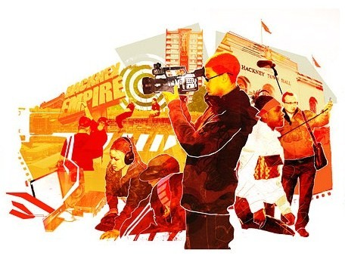
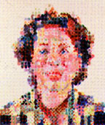
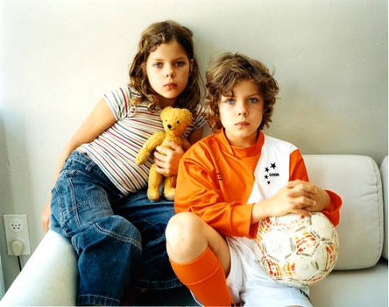
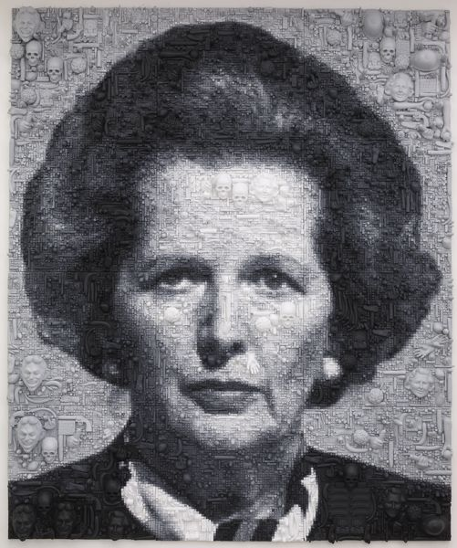
Aging and Growth
Identity, portraiture, story-telling and hobbies, age, decay, maturity, youth, memories, generations, culture, appearance, childhood, dementia, old age, history, era, nostalgia.
Chuck Close
Andy Warhol,
Guy Bourdin,
Jo Spence,
Sam Taylor-Wood,
Robert Longo,
Sally Mann,
Lara Jade,
Cindy Sherman,
Ryoko Suzuki,
John Coplans,
Lucian Freud,
Annette Messager,
Judy Chicago,
Marlene Dummas,
Helen Chadwick,
Guerilla Girls,
Ghada Amer,
Mary Kelley,
Ivonne Thein,
Marcus Harvey,
Orlan,
Jenny Saville,
Mark Gilbert,
Marlene Dummas,
Maggie Hambling,
Pablo Picasso,
Edvard Munch,
Gustav Klimt,
Peter Blake,
Banksy,
Gillian Wearing,
Julian Opie,
Roy Lichtenstein,
Clauding Hellmuth,

Slide 2
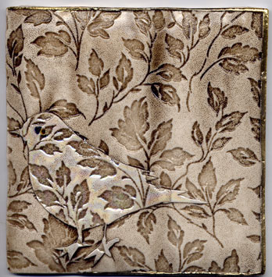
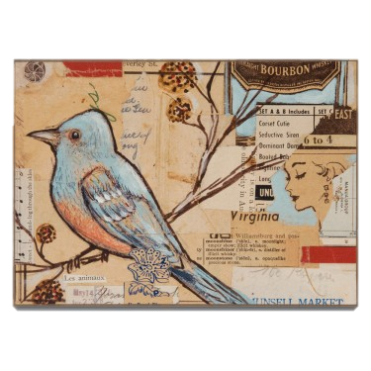
Surfaces of Nature
Nature forms, ground surfaces, patterns and textures. Opposite: geometric / tessellation. Rural vs urban. Animals, recycling, climate change. Bactria, microbiology.
Ingrid Dijlars,
Susie MacMurray
The Boyle Family,
Michael Brenannd-Wood,
Tracey Bush,
Lesley Brickell,
Dolan Geiman,
Chris Jordan,
Anish Kapor,
Joseph Beuys,
Frank Auerbach
Jan Beany,
Julia Burrows,
Claire Heathcote,
Dolan Geiman,
Rowan Marsh,
Alex Russell,
Tracy Emin,
Lynne Perrella,
Jennifer Collier,
Rosamund Purcell,
Brian Dettnier,
Nicholas Jones,
Claire Humphries,

Slide 3
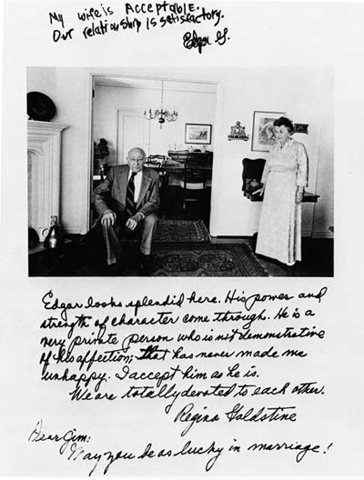
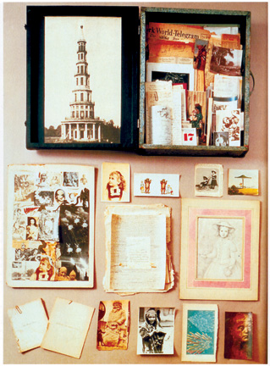
Memories & Moments
Memories, personal possessions, relationships, meetings, experiences, historical moments, fiction, story telling, illustration, news, fact vs fiction, future.
Kurt Jackson,
Ruth Watson
Jane Hammond,
Ibrahim Miranda,
Vik Muniz,
Ingo Gunther,
Lynne Perrella,
Katy Lemay,
Tracy Moffatt ,
Michelle Thompson ,
Dolan Geiman,
Elaine Hughes,
Traci Bunkers,
Teesha Moore,
Audrey Flack,
Michael Wolf,
Giacomo Balla,
Damien Hirst,
Myah Bailey,
Christian Boltanski,
Audrey Flack,
Kathe Kollwitz,
Rachel Whiteread,
Debbie Smyth,
Jim Goldberg,
Chris Jordan,
Jean Cody,
Jamie Primrose,

Slide 4
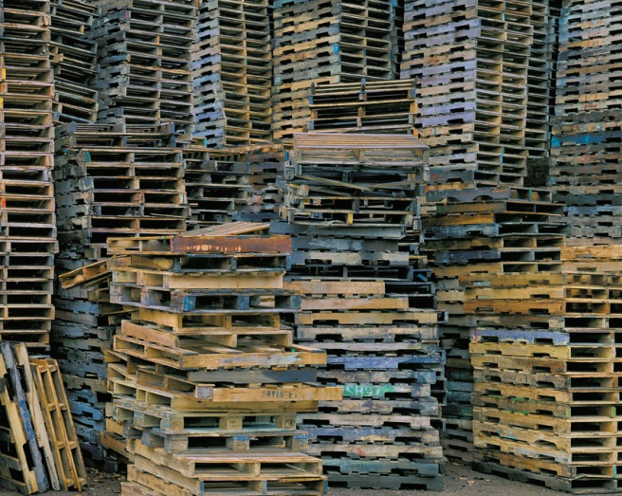
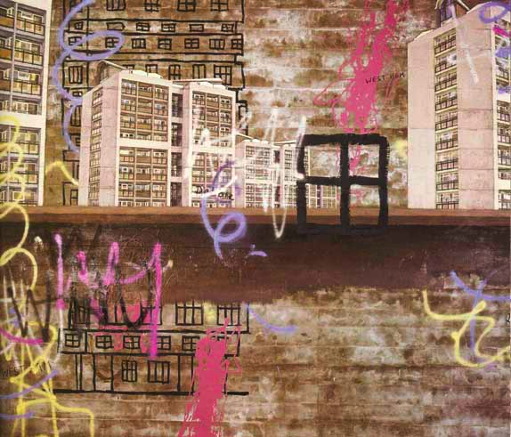
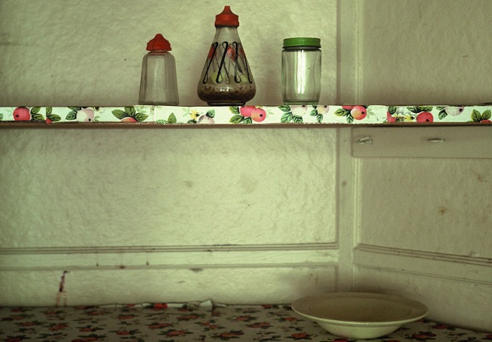
Urban life & Architecture
Journeys, landscapes, location, memories, architecture, youth culture, music, graffiti, street art, fashion, travel, urban vs rural, old vs new, rich vs poor.
John Piper,
Ben Watts
Tyler Burke, Dolan Geiman,
Henri Cartier–Bresson,
Chris Jordan,
David Hockney,
Brian Wells,
Steven Javiel,
Michael Wolf,
Janice Caswell,
Graham Sunderland,
Van Gogh,
Angie Lewin,
Debbie Smyth,
Paul Catherall,
Lucy Jones,
Daniel Shiel,
Elaine Hughes,
Victoria Ashworth,
David Hepher,
Alicia Bock,
Cassia beck,
Wayne Thiebaud,
Kurt Jackson,

Slide 5
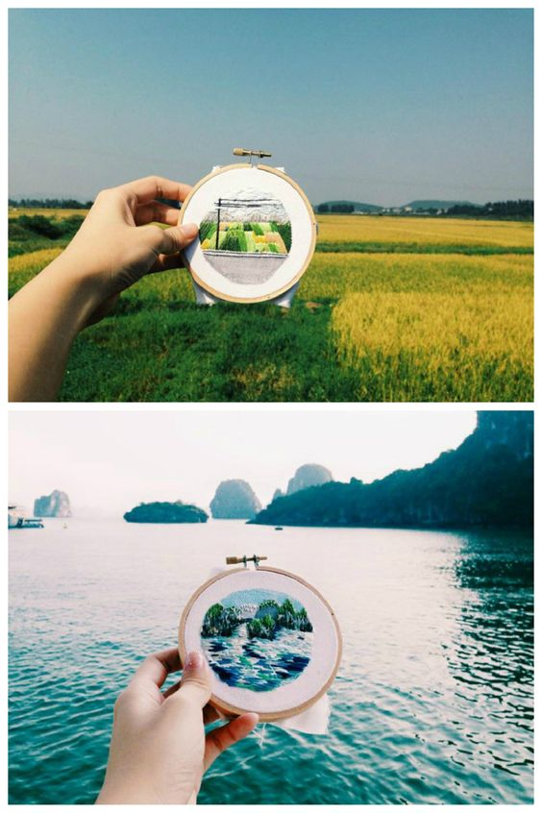
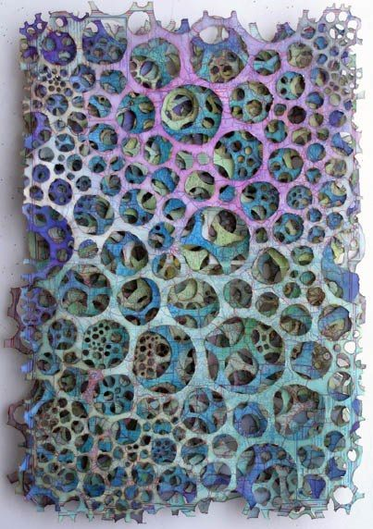
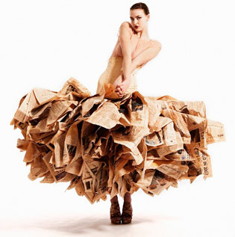
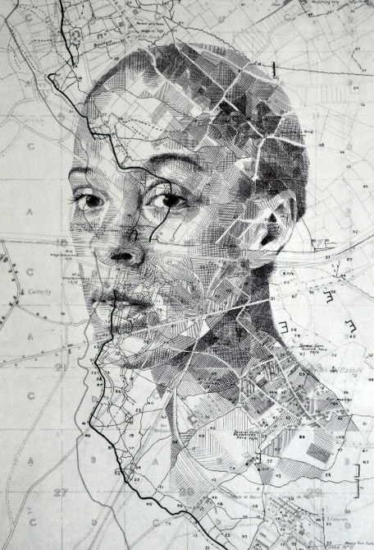
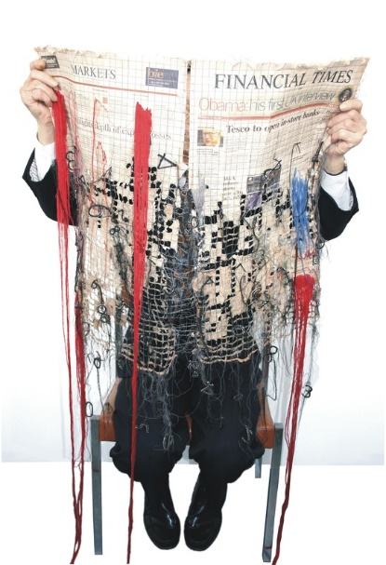
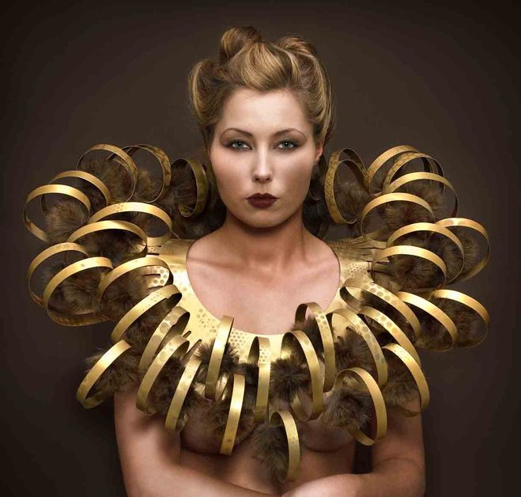
Travel, Culture & Pattern
Journeys, Travel, mode of travel, Country's’, Culture, Religion, was of life, Holiday, Fashion, Patterns, Nature [from other country's’] Science
Val Hunt,
Nancy Judd
Vivienne Westwood,
Susan Stockwell,
Louise Nippierd,
Jennifer Booher
Rowan Mersh,
Ed Fairburn
Sarah Lugg
Teresa Lim
Katie Essam
Karen Margolis
John Clang
Kirsty Whitlock
Mark Powell

Slide 6
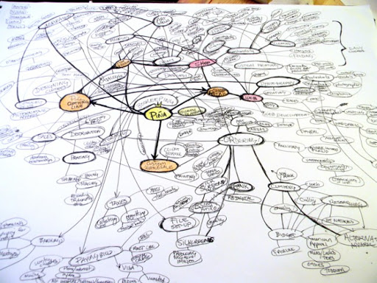
Mind Map: From either your own theme or one of the ones we have suggested, create a mind map of everything you can think of.
Start with everything you can think of that links
Remember to add links to links
Add any books or novels
Add any films, tv or music
Add any news stories
Add any personal events

Slide 7
Make sure you complete the following tasks for your first lesson in September
Summer Task:
Take relevant and interesting photographs exploring your chosen theme
A visual mind map (collage) of artists/designers that relate to your theme
Use the support materials to create some expressive drawings

